Slide 1
Credit Card Default Prediction

Slide 2
Objective:
Development of a predictive model for determining the defaulters of the credit card before allotting it to customer. This will help the bank to prevent losses.
Benefits:
Detection of upcoming defaulters
Gives better insight of customers base
Helps in easy flow for managing resources
Manual inspection if fraud is identified

Slide 3
Dataset / Data Sharing Agreement:
A public dataset has been used (link below) that contains information on default payments, demographic factors, credit data, history of payment, and bill statements of credit card clients in Taiwan from April 2005 to September 2005.
There are 25 variables in the datasets like educational qualification, repayment status, bill settlement amounts, etc.
Dataset Link

Slide 4
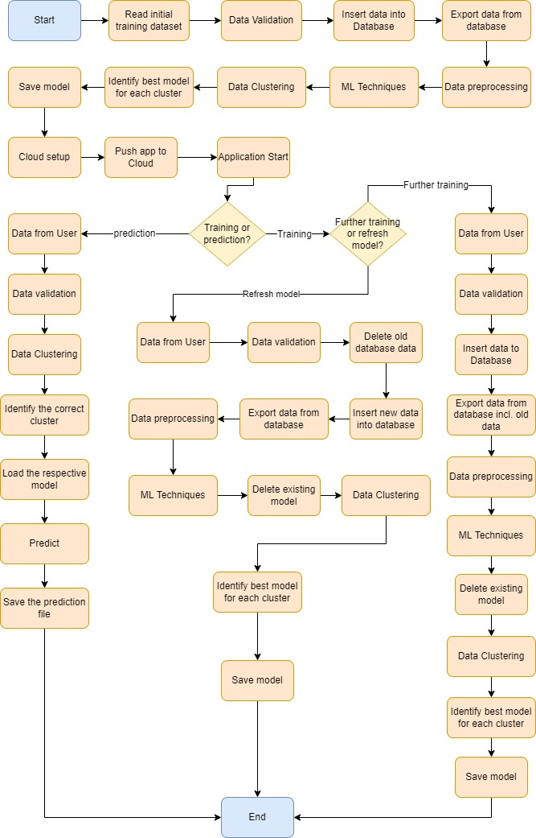
Architecture

Slide 5
Data Validation & Data Transformations
Number of columns – Validation of number of columns present in the files, and if it doesn't match then the file is moved to "Bad_Data_Folder.“
Data type of columns – The data type of columns is given in the schema file. It is validated when we insert the files into Database. If the data type is wrong, then the file is moved to "Bad_Data_Folder".
NULL values in columns – NULL values are marked as ‘NULL’ incase of record insertion in database. On the other hand, while training the model, the NULL values are imputed.

Slide 6
Data Insertion in Database
Table creation – Table name ‘training_data’ is created in the database for inserting the records. Depending on the mode as selected by the user, the data will be either appended to the existing table or the database table will be deleted and it will be loaded with the new data
NULL values in columns – NULL values are marked as ‘NULL’ incase of record insertion in database.
Insertion of files in the table – All the files in the "Good_Data_Folder" are inserted in the above-created table. If any file has invalid data type in any of the columns, the file is not loaded in the table

Slide 7
Model Training
Data Export from DB
The accumulated data from DB is exported in CSV format for model training
Data Preprocessing
Performing EDA to get insight of data like identifying distribution, outliers, trend among data etc.
Check for null values in the columns. If present impute the null values.
Encode the categorical values with numeric values.
Perform Standard Scalar to scale down the values.

Slide 8
Model Training
Clustering
KMeans algorithm is used to create clusters in the preprocessed data. The optimum number of clusters is selected by plotting the elbow plot, and for the dynamic selection of the number of clusters, we are using Knee-Locator function. The idea behind clustering is to implement different algorithms on the structured data. The K-means model is trained over preprocessed data, and the model is saved for further use in prediction
Model Selection
After the clusters are created, we find the best model for each cluster. By using 2 algorithms “SVM” and "XGBoost". For each cluster both the hyper tuned algorithms are used. We calculate the AUC scores for both models and select the model with the best score. Similarly, the model is selected for each cluster. All the models for every cluster are saved for use in prediction.

Slide 9
Prediction
The testing files are shared in the batches and we perform the same Validation operations, data transformation and data insertion on them.
The accumulated data from DB is exported in CSV format for prediction
We perform data pre-processing techniques on it.
K-Means model created during training is loaded and clusters for the preprocessed data is predicted.
Based on the cluster number, respective model is loaded and is used to predict the data for that cluster.
Once the prediction is done for all the clusters, the predictions are saved in CSV format in S3 Bucket.

Slide 10
Q & A
Q1) What’s the source of data?
Public dataset has been used the link for which is given in slide 3
Q 2) What was the type of data?
Numerical values
Q 3) What’s the complete flow you followed in this Project?
Refer slide 4 for better Understanding
Q 4) After the File validation what you do with incompatible file or files which didn’t pass the validation?
Files like these are moved to the Bad folder which can be cleaned later
Q 5) How logs are managed?
There are separate logs for validation, training and predictions.
Q 6) What techniques were you using for data pre-processing?
Visualizing relation of independent variables with each other and output variables
Checking and changing Distribution of continuous values
Removing outliers
Cleaning data and imputing if null values are present.
Converting categorical data into numeric values.
Scaling the data

Slide 11
Q & A
Q 7) How training was done or what models were used?
Before diving the data in training and validation set we performed clustering over fit to divide the data into clusters. As per cluster the training and validation data were divided. The scaling was performed over training and validation data. Algorithms like SVM, XGBoost, Decision Tree, etc. were used based on the recall final model was used for each cluster and we saved that model .
Q 8) How Prediction was done?
The testing files are shared by the client. We Perform the same life cycle till the data is clustered. Then on the basis of cluster number model is loaded and perform prediction. In the end we get the accumulated data of predictions.
Q 9) What are the different stages of deployment?
When the model is ready we deploy it in Fire environment .Where SIT and UAT is performed over it.
Once We get Sign off from Fire we deploy in Earth and UAT is performed over it.
After getting the sign off from Earth we deploy in production

